Slide 1
Transition to Adulthood - The College Choice
How to pay
Where to go
Who can help
What to study
Is it even worth it
When to start the process

Slide 2
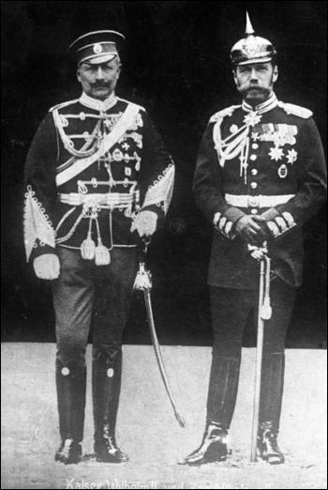
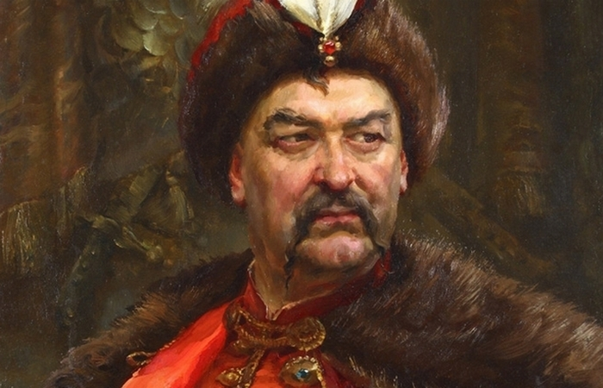
Education is a good thing.
Apply your heart to discipline And your ears to words of knowledge. (Proverbs 23:12)
Everyone Agrees!
Well… almost everyone

Slide 3
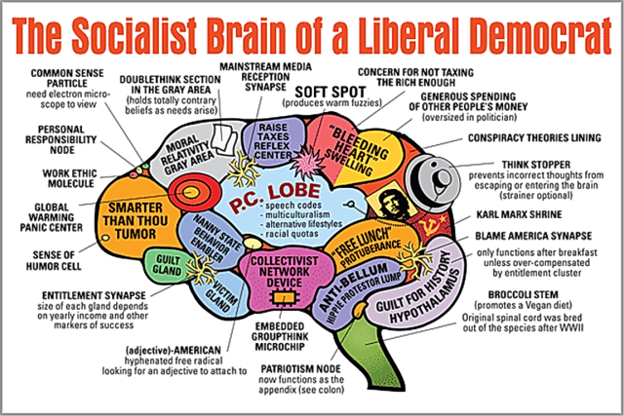
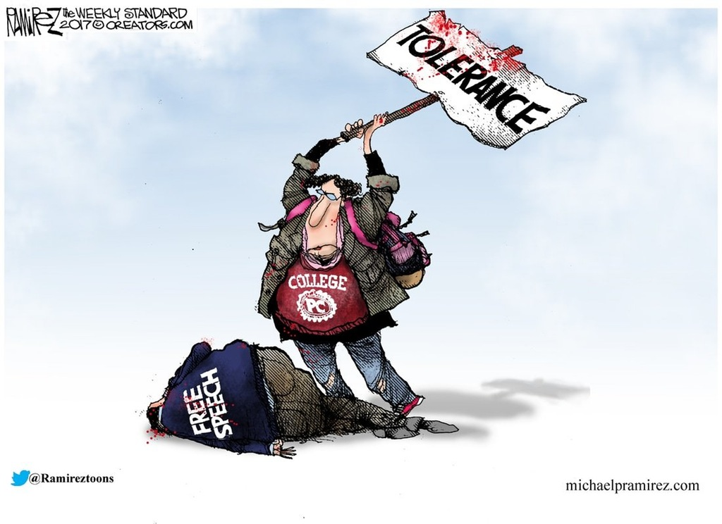
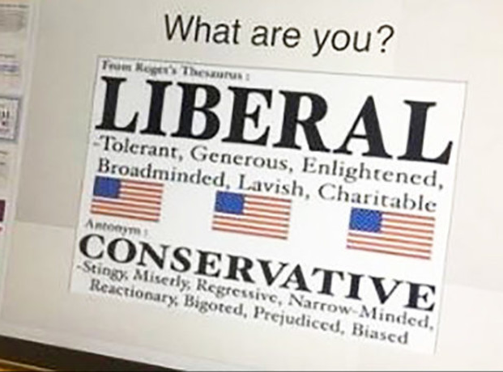
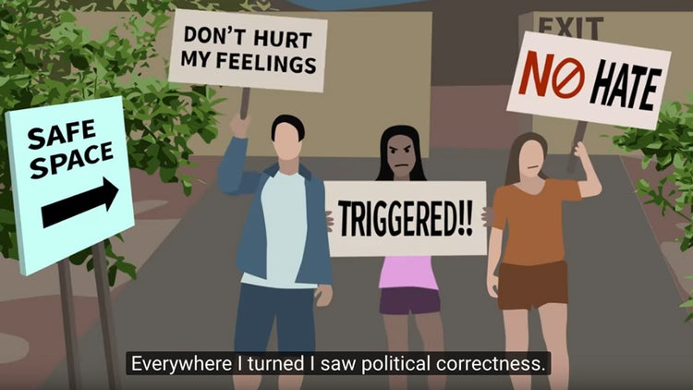
Let’s talk about the elephant!

Slide 4
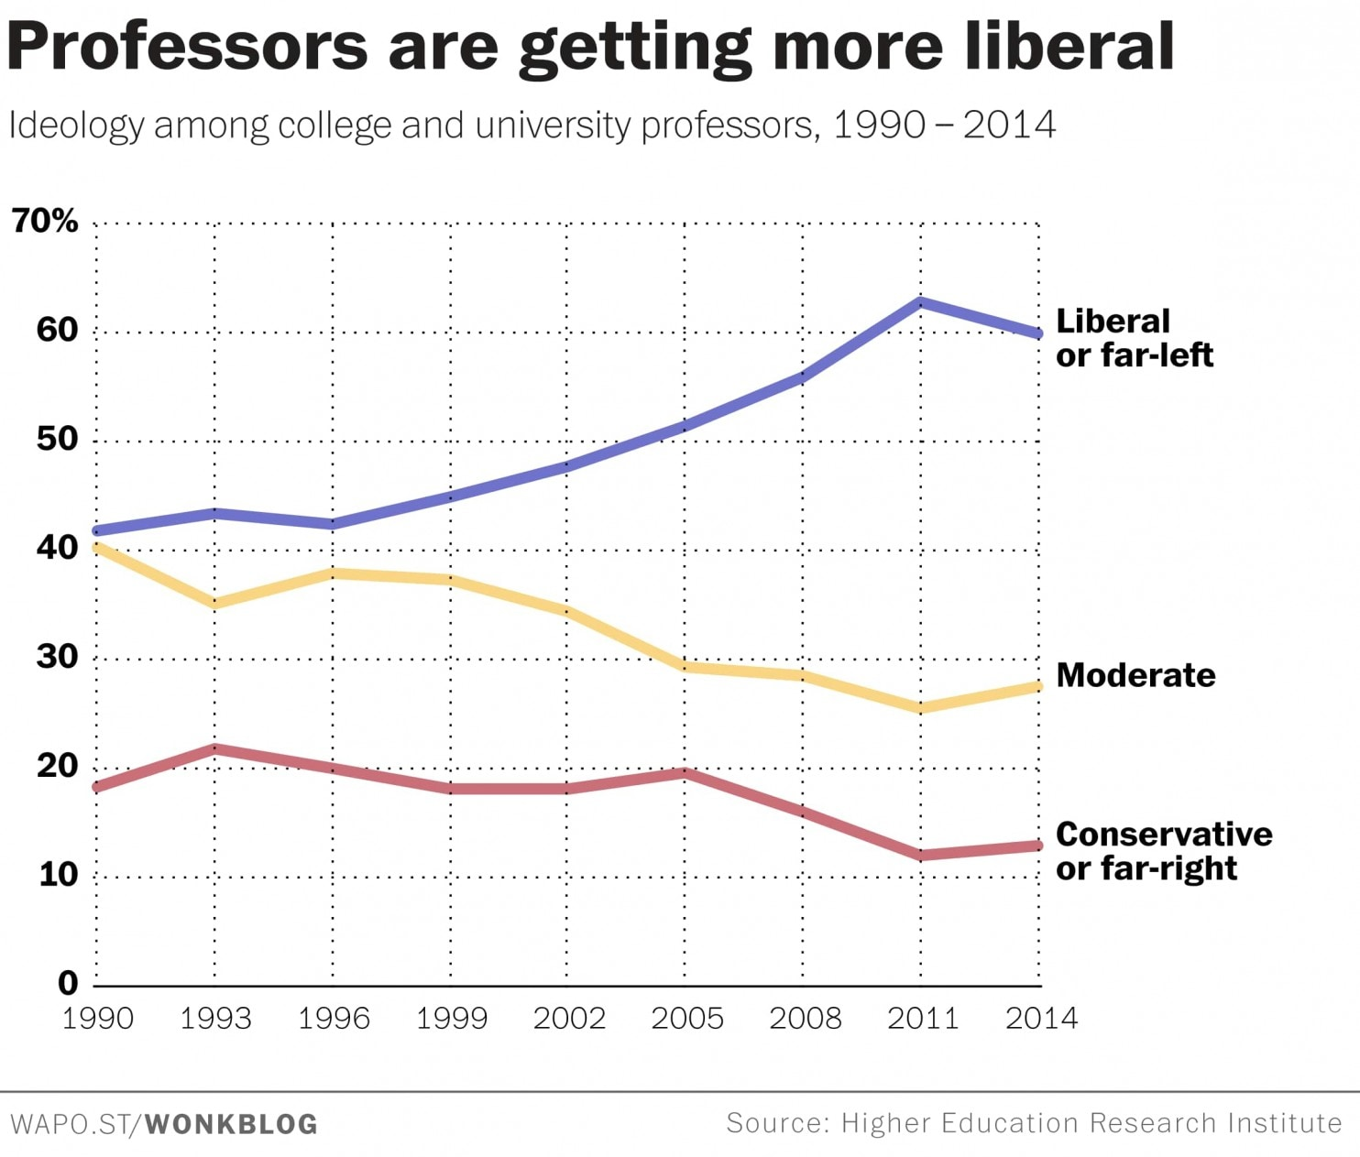
Liberal teaching: Evidence
Fear exists that colleges are in the business of indoctrinating the kids toward liberal or leftist ideology.
Some anecdotes have claimed that a conservative ideology entering college gets strengthened
Some colleges are predominantly “liberal” or “conservative” – www.myplan.com
Regardless of a school’s predominant ideology, there will be curricula that teaches critical thinking, logic, rational argumentation, etc.
Mainstream research on this topic can lead one down various paths depending on what one chooses to believe – the arguments are compelling on both sides. But that debate is for a different seminar…

Slide 5
Now we can – for the moment – leave the elephant behind.
Regardless of your feelings about that whole issue, you are probably here today because you are considering a college education either for yourself or someone else.
Why?

Slide 6
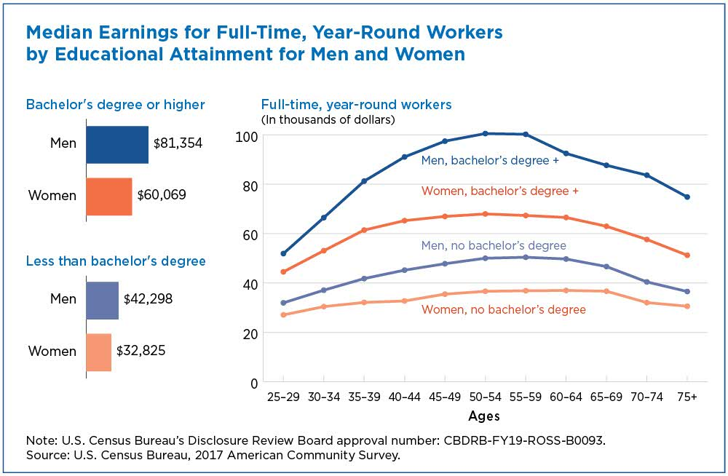
According the 2017 U.S, Census data, College graduates earned 56% more than high school grads. Plus other benefits like health insurance, vacation time, and retirement plans.
(But, don’t forget about Uncle Sam… College Graduates pay $563,000 more in taxes over the length of their career than those without a degree.)

Slide 7
An Article from the Chicago Tribune by Mark A. Heckler entitled The Importance of a College Education makes some interesting points. For example he says that todays careers, more than ever, require employees to be versatile and flexible. College can offer many experiential opportunities and “soft skills” in addition to academics.
Time management
Handling multiple projects
Self advocacy
Networking
Another consideration:
A paper published in The Journal of Higher Education: “Women Students at Coeducational and Women’s Colleges: How Do Their Experiences Compare?” – shows that single sex schools may offer an educational advantage, especially for women.
“…women’s college respondents reported making more progress in every measure tested.”

Slide 8
Review of Educational Research is a peer reviewed publication that reports on and studies education. In the abstract of this paper: Does College Teach Critical Thinking? A Meta-Analysis there is the following quote:
“The results suggest that both critical thinking skills and dispositions improve substantially over a normal college experience.”
And further in the paper there is a statement that is relevant here:
“If college can promote general skepticism toward questionable claims and ideas, especially ones that mesh with one’s own worldview, it has surely performed a valuable function. Although individuals lack the specific knowledge needed to critically analyze every domain, a disposition toward critical thinking should at least encourage acquisition of additional knowledge and reservation of judgment.”
In my words: If college can get a student to question the things around them, and attempt to answer those questions, it has done a good thing.
There are obvious questions about the organization, the paper, and methods used to come up with the findings. But, with a good dose of critical thinking employed and some time to actually read the article, what will you find…?

Slide 9
Trade School Alternative
Some compelling reasons to consider attending a trade school:
Typically 2 years of school
Wages are good
Salary difference is minimal on average compared to 4 year school
Job security can be higher – outsourcing overseas is not common
Overall cost and potential debt is substantially less

Slide 10
What about kids who were homeschooled?
One study showed that homeschooled students who went to college away from home felt as though they were raised in a different culture, but they felt equally or slightly more capable academically, more self-directed in their studies, and closer to their families than their traditionally schooled peers did.

Slide 11
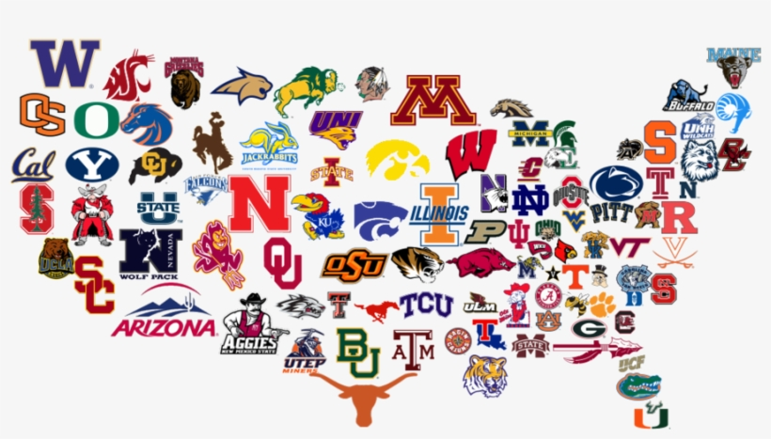
When to start considering the choice?
It is never too early.
What major to pick?
Start with personal interests and fields of study.
How to decide which school?
Attend a College fair - https://www.nacacnet.org/
Create a spreadsheet that lists important criteria
Size
Distance
Acceptance rate
Programs / Majors
Cost
Campus style (city / rural / pretty / ugly)
School colors
Etc.
How does one prepare?
Common Application
Ask a local HS guidance counselor
Collegeboard.org

Slide 12
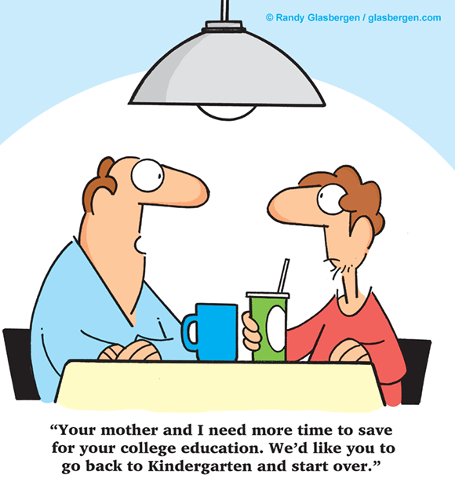
Paying for college
Save early – 529 program
UPromise credit card (Barclay)
Financial aid through the school
FAFSA
Need based awards
Merit based awards
negotiating and appealing
Scholarships:
https://studentaid.ed.gov
https://www.careeronestop.org/toolkit/training/find-scholarships.aspx

Slide 13
Have conversations to prepare the kid for:
Influences they will be subjected to
Pressure they might feel to fit in
Life decisions they will need to make on their own
Making the right choices for their health and safety
Being financially independent and savvy
Time management and study skills
Confidence to approach campus resources for help.
Resources:
https://axis.org/
Focus on the family

