Slide 1
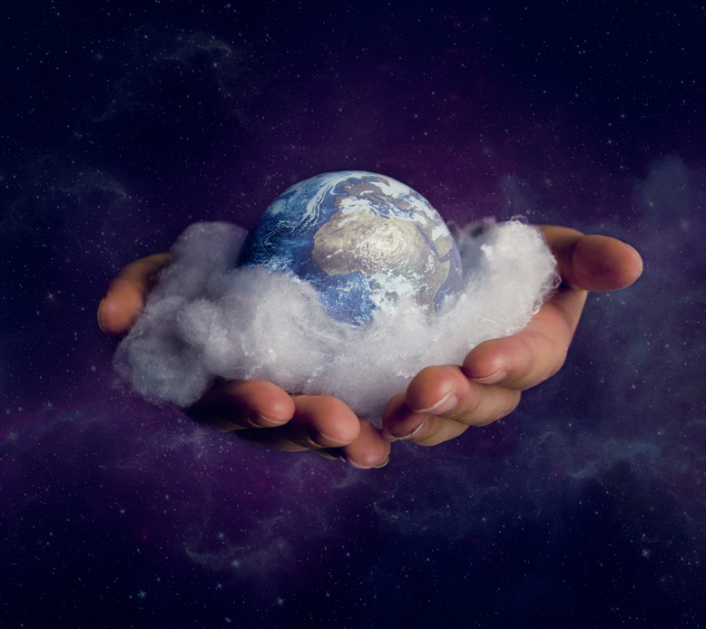
Creation
made in His Image

Slide 2
When was Creation? – Day One: Light
In the beginning God created the heavens and the earth. The earth was formless and void, and darkness was over the surface of the deep, and the Spirit of God was moving over the surface of the waters. Then God said, "Let there be light"; and there was light. God saw that the light was good; and God separated the light from the darkness. God called the light day, and the darkness He called night. And there was evening and there was morning, one day. (Genesis 1:1-5)

Slide 3
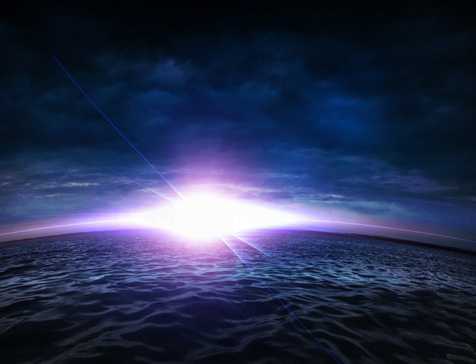
Day Two: Water and Earth
Then God said, "Let there be an expanse in the midst of the waters, and let it separate the waters from the waters." God made the expanse and separated the waters which were below the expanse from the waters which were above the expanse; and it was so. God called the expanse heaven. And there was evening and there was morning, a second day. (Genesis 1:6-8)

Slide 4
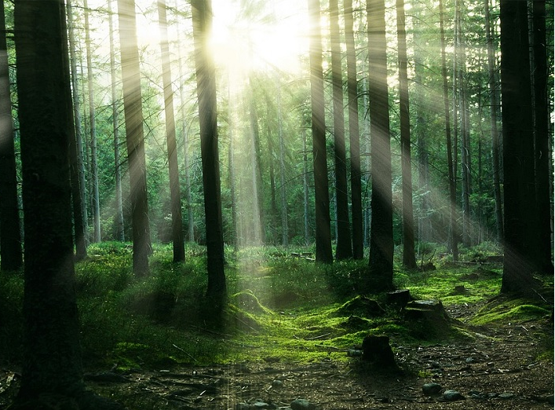
Day Three: Dry Land and Vegetation
Then God said, "Let the waters below the heavens be gathered into one place, and let the dry land appear"; and it was so. God called the dry land earth, and the gathering of the waters He called seas; and God saw that it was good. Then God said, "Let the earth sprout vegetation, plants yielding seed, and fruit trees on the earth bearing fruit after their kind with seed in them"; and it was so. The earth brought forth vegetation, plants yielding seed after their kind, and trees bearing fruit with seed in them, after their kind; and God saw that it was good. There was evening and there was morning, a third day. (Genesis 1:9-13)

Slide 5
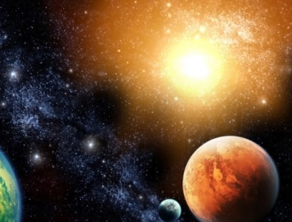
Day Four: Sun and Moon and Stars
Then God said, "Let there be lights in the expanse of the heavens to separate the day from the night, and let them be for signs and for seasons and for days and years; and let them be for lights in the expanse of the heavens to give light on the earth"; and it was so. God made the two great lights, the greater light to govern the day, and the lesser light to govern the night; He made the stars also. God placed them in the expanse of the heavens to give light on the earth, and to govern the day and the night, and to separate the light from the darkness; and God saw that it was good. There was evening and there was morning, a fourth day. (Genesis 1:14-19)

Slide 6
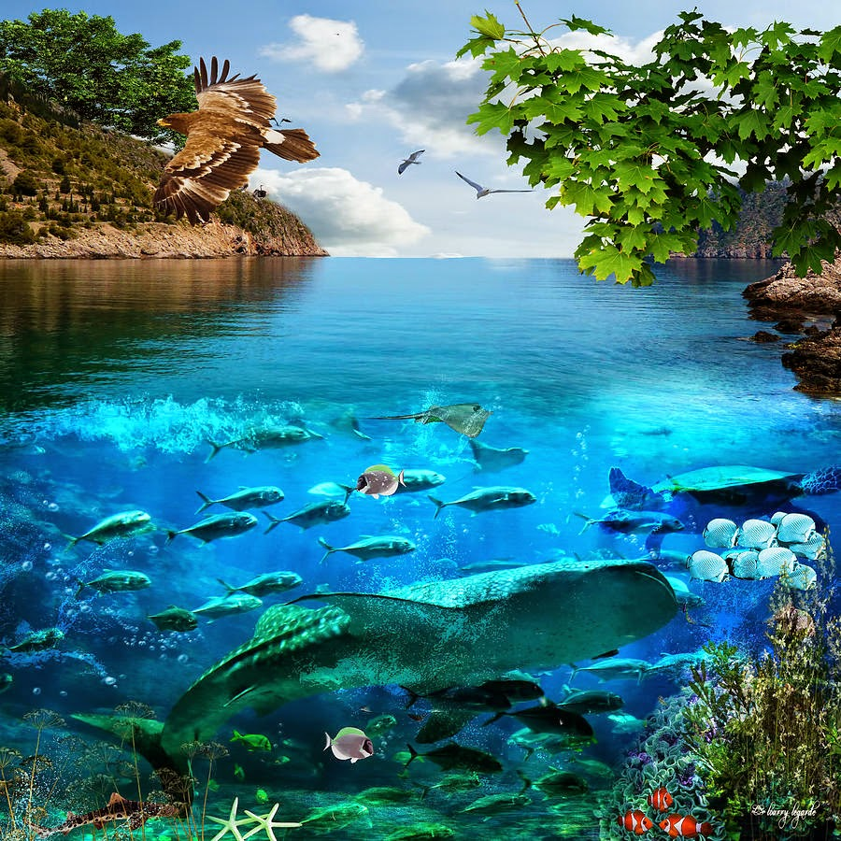
Day Five: Birds and Fish
Then God said, "Let the waters teem with swarms of living creatures, and let birds fly above the earth in the open expanse of the heavens." God created the great sea monsters and every living creature that moves, with which the waters swarmed after their kind, and every winged bird after its kind; and God saw that it was good. God blessed them, saying, "Be fruitful and multiply, and fill the waters in the seas, and let birds multiply on the earth." There was evening and there was morning, a fifth day. (Genesis 1:20-23)

Slide 7
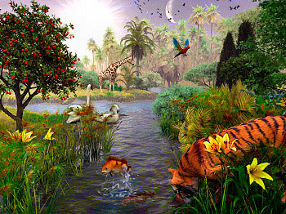
Day Six: Animals and People
Then God said, "Let the earth bring forth living creatures after their kind: cattle and creeping things and beasts of the earth after their kind"; and it was so. God made the beasts of the earth after their kind, and the cattle after their kind, and everything that creeps on the ground after its kind; and God saw that it was good. Then God said, "Let Us make man in Our image, according to Our likeness; and let them rule over the fish of the sea and over the birds of the sky and over the cattle and over all the earth, and over every creeping thing that creeps on the earth." (Genesis 1:24-26)

Slide 8
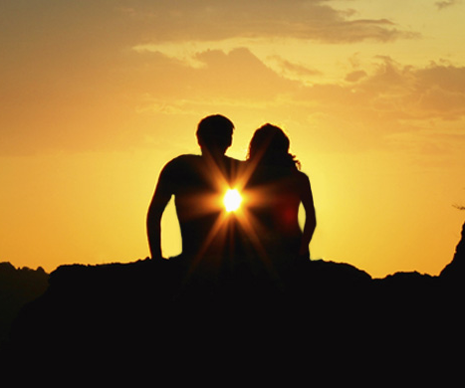
Day Six: Animals and People
God created man in His own image, in the image of God He created him; male and female He created them. God blessed them; and God said to them, "Be fruitful and multiply, and fill the earth, and subdue it; and rule over the fish of the sea and over the birds of the sky and over every living thing that moves on the earth." Then God said, "Behold, I have given you every plant yielding seed that is on the surface of all the earth, and every tree which has fruit yielding seed; it shall be food for you; and to every beast of the earth and to every bird of the sky and to every thing that moves on the earth which has life, I have given every green plant for food"; and it was so. God saw all that He had made, and behold, it was very good. And there was evening and there was morning, the sixth day. (Genesis 1:27-31)

Slide 9
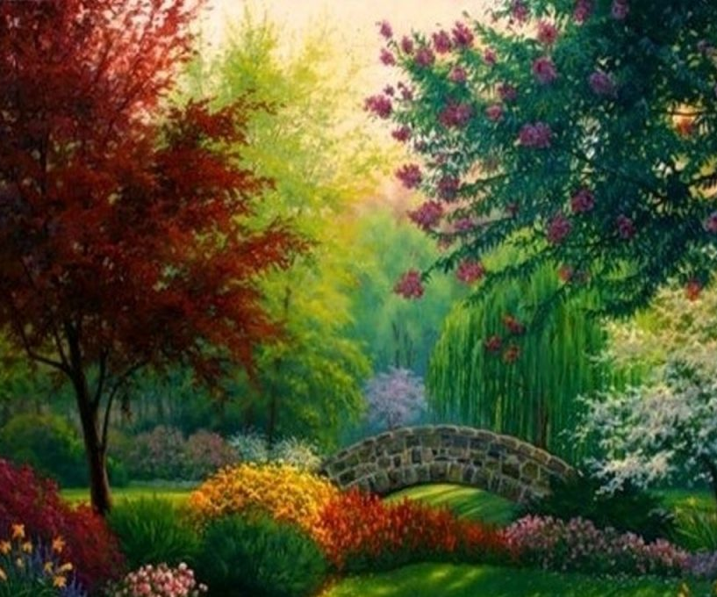
Day Seven: The Day of Rest - Sabbath
Thus the heavens and the earth were completed, and all their hosts. By the seventh day God completed His work which He had done, and He rested on the seventh day from all His work which He had done. Then God blessed the seventh day and sanctified it, because in it He rested from all His work which God had created and made. (Genesis 2:1-3)

Slide 10
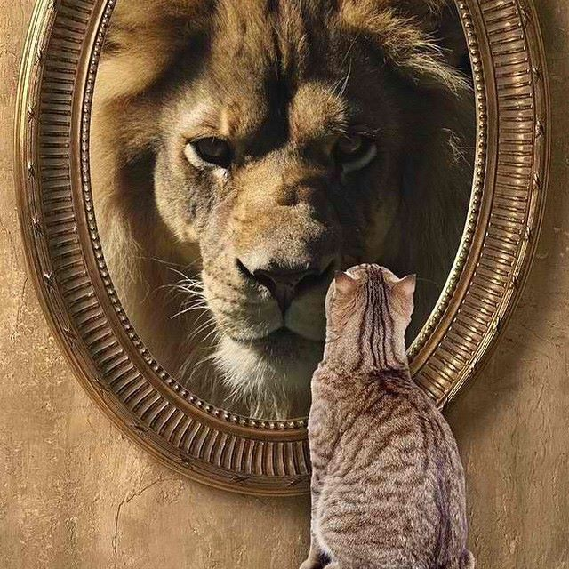
People are made in God’s image
Read this again:
Then God said, "Let Us make man in Our image, according to Our likeness; and let them rule over the fish of the sea and over the birds of the sky and over the cattle and over all the earth, and over every creeping thing that creeps on the earth." God created man in His own image, in the image of God He created him; male and female He created them. (Genesis 1:26-27)
What does that mean?
“…in His image…”
“…according to His likeness…”

Slide 11
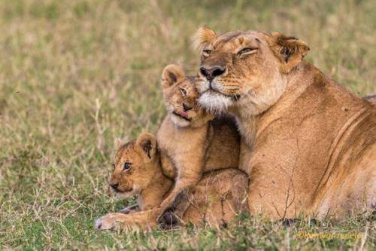
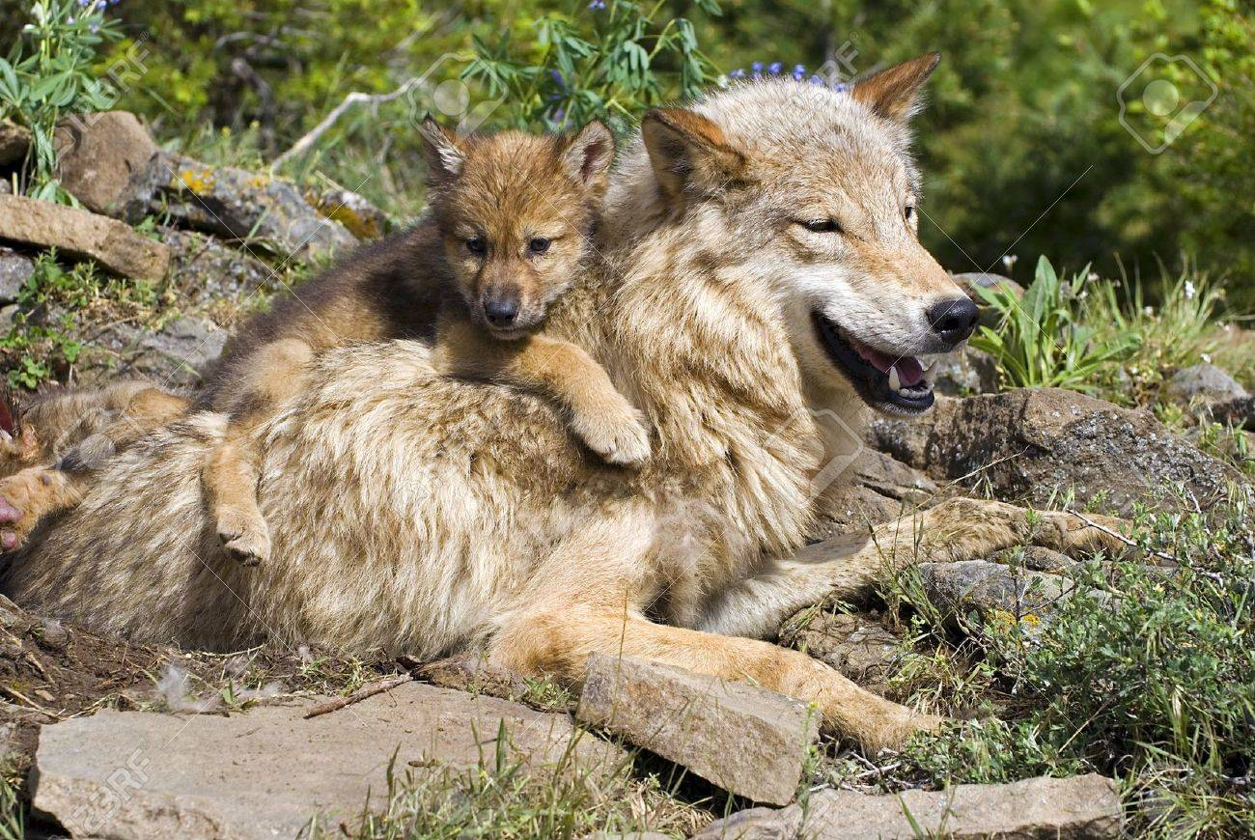
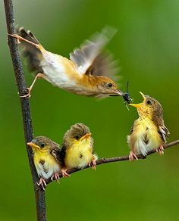
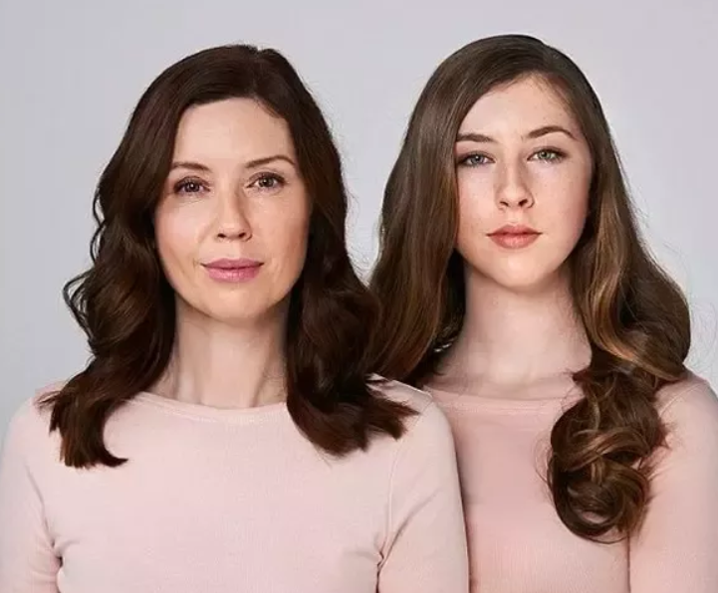
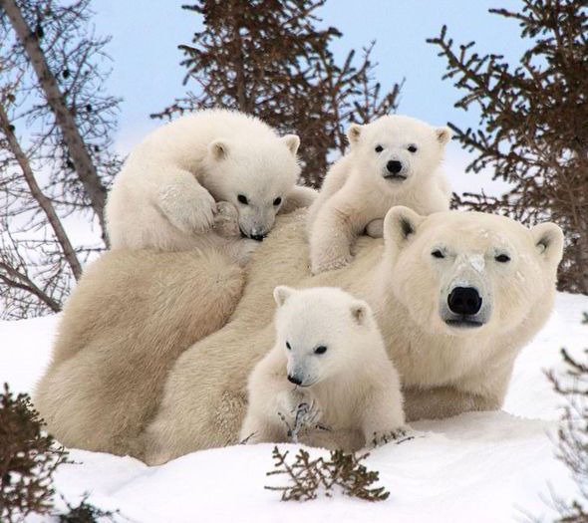
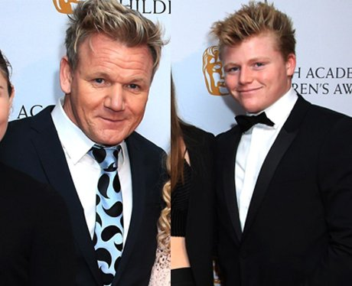
God’s image & God’s likeness
Children look like their parents and as they grow up, they look more and more alike.
But the likeness is not just how they look, but also how they act – what they do.

Slide 12
Moms and Dads – What do they do?
Things that Moms mostly do:
Clean the house
Things that Dads mostly do:
Fix things

Slide 13
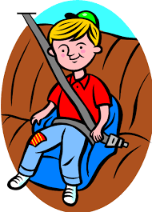
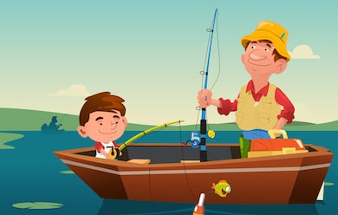
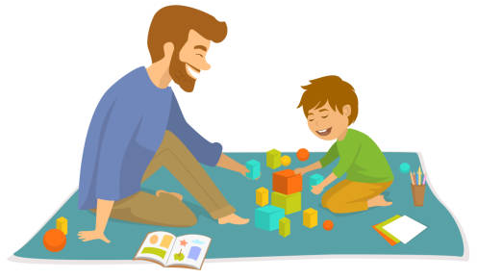
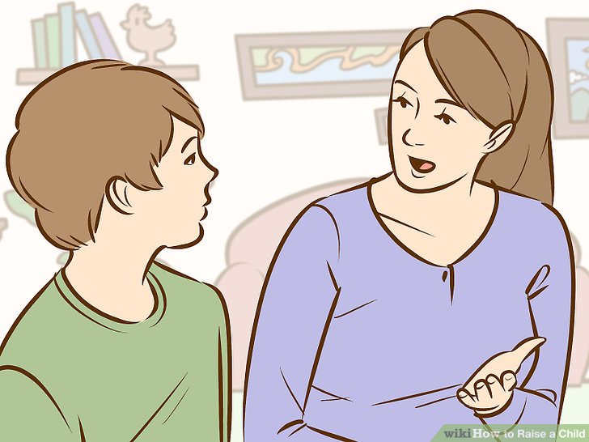
Moms and Dads provide what we need

Slide 14
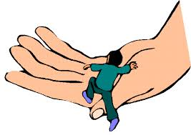
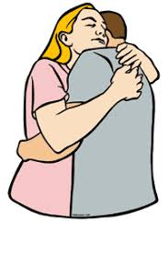
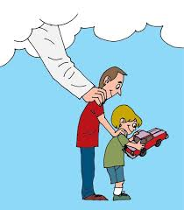
God does what moms and dads do.
Things that God does:
Create
Protect
Provide
Heal
Forgive
Guide
Love
Comfort
Much more…!!

Slide 15
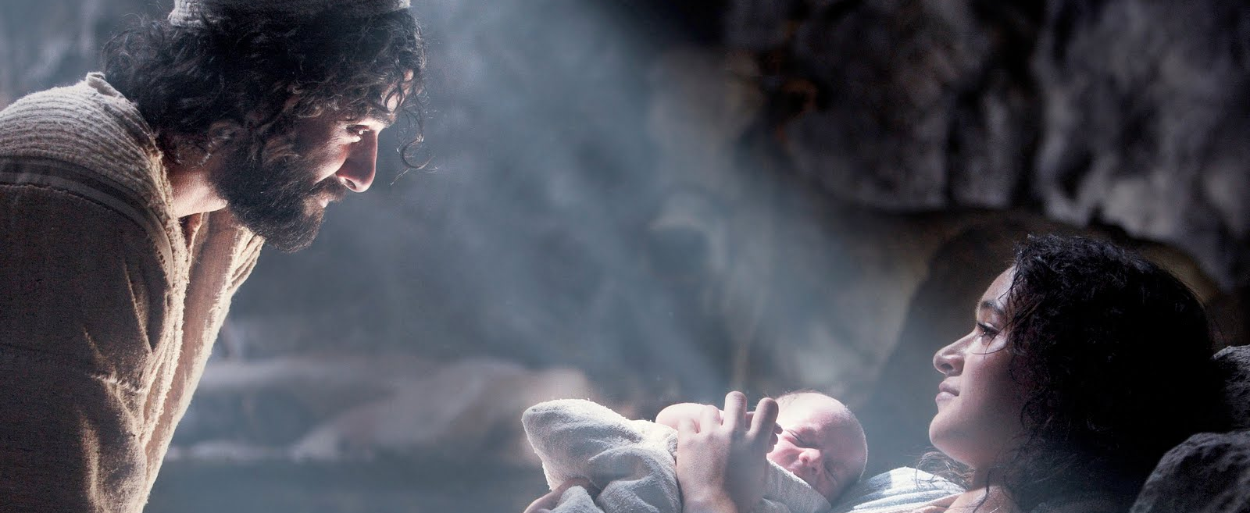
God came to earth as a man…
Messiah was our likeness:
He got hungry (Mark 11:12 “Now the next day, as they went out from Bethany, he was hungry. “
He got tired (John 4:6 “Jacob’s well was there, so Jesus, since he was tired from the journey, sat right down beside the well. It was about noon.”)
He got sad (John 11:35 “Jesus wept.”)
He got angry (Mark 11:15 “…He turned over the tables of the money changers and the chairs of those selling…”
He made jokes (Mark 10:25 “It is easier for a camel to go through the eye of a needle than for a rich person to enter the kingdom of God.”
He was tempted (Matthew 4:1 “…Jesus was led by the Spirit into the wilderness to be tempted…”
He worked (Mark 6:3 “Isn’t this the carpenter, the son of Mary…?”)
He showed compassion (Matthew 9:36 “When he saw the crowds, he had compassion on them…”)
Much more…!!

Slide 16
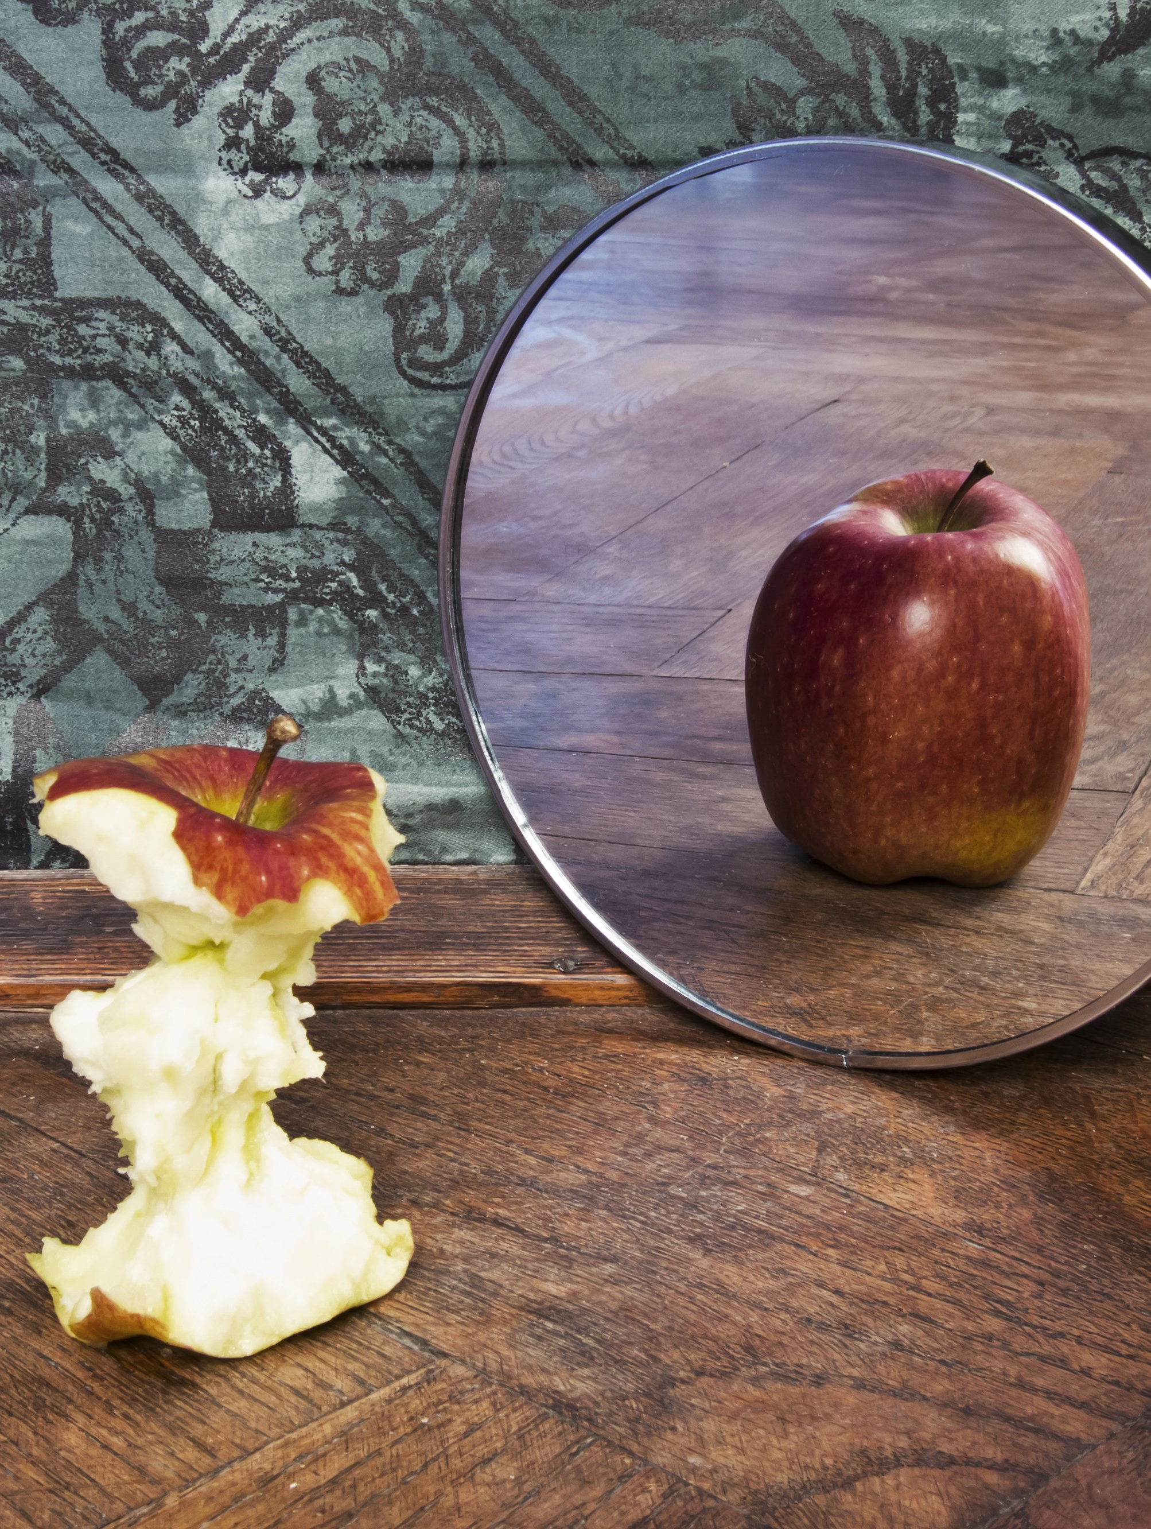
We are becoming a reflection of God
But we all, with open face beholding as in a glass the glory of the Lord, are changed into the same image from glory to glory, even as by the Spirit of the Lord. (2 Corinthians 3:18 KJV)
But we all, with unveiled face, beholding as in a mirror the glory of the Lord, are being transformed into the same image from glory to glory, just as from the Lord, the Spirit. (2 Corinthians 3:18 - NAS)
All of us! Nothing between us and God, our faces shining with the brightness of his face. And so we are transfigured much like the Messiah, our lives gradually becoming brighter and more beautiful as God enters our lives and we become like him. (2 Corinthians 3:18 - The Message)

